Slide 1

Using Dynamics CRM as a Software Fulfillment Engine

Slide 2

Mitch Milam
Dynamics CRM Architect
mitch@xrmcoaches.com
blogs.Infinite–x.net
@mitchmilam

Slide 3
Teaching Tuesdays
Cast your vote now
http://tinyurl.com/TeachingTuesdays

Slide 4
Series

Slide 5
Agenda
Business requirements
Current and future business process
Automation goals
Solution components
Automation components

Slide 6
Customer Backgrounder
Small ISV
Creates utilities and components that integrate with Dynamics CRM
Services customers from around the world

Slide 7
Business Requirement
Complete automation of the
software fulfillment process

Slide 8
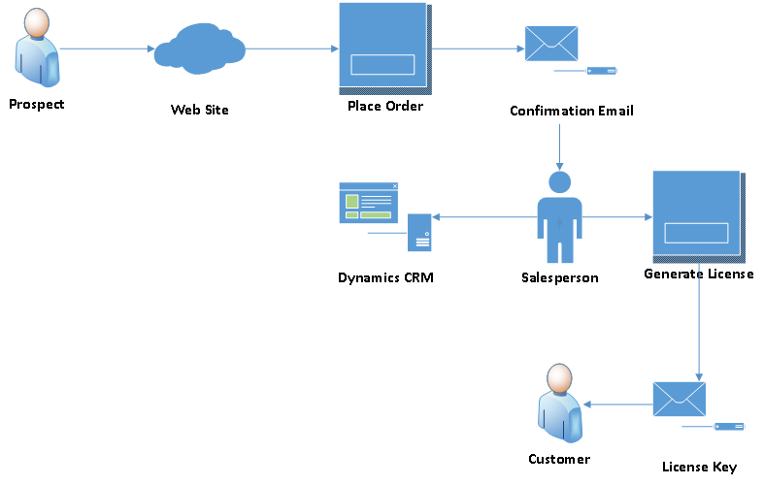
Current Business Process

Slide 9
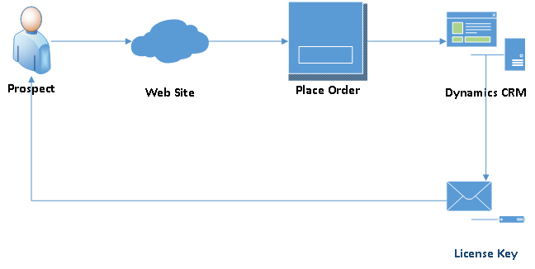
Ideal Business Process

Slide 10
Automation Goals
Physical product sale
Capture customer and product information
Product license creation and delivery

Slide 11
Goal #1: Physical Product Sale
Internet–based shopping cart
Payments handled through PayPal
Automatic delivery of electronic goods
Confirmation email sent to customer and vendor

Slide 12
Goal #1: Requirements
None
Physical sales process works as desired

Slide 13
Goal #2: Capture Sale Information
Required a shopping cart configuration change
Additional confirmation email sent to a secondary email address
Email address is a Dynamics CRM Queue
Added to CRM by the Email Router Service

Slide 14
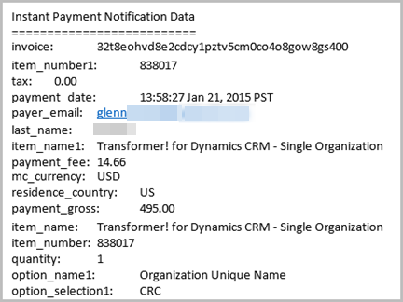
Confirmation Email
Key to the entire automation process
Contains
Customer information
Product information

Slide 15
Goal #2: Requirements
Customize Dynamics CRM to capture sale information
Add confirmation email to Dynamics CRM
Extract sale data from the mail
Create necessary CRM records

Slide 16
Customization Process
Use existing CRM entities, where possible
Create new entities as necessary
Create automation components to facilitate order processing and license generation

Slide 17
Solution Components – Entities
Standard Entities
Contact
Custom Entities
Product Purchase
License Generator

Slide 18
Solution Components – Automation
Plug–ins
Smart Web Import
License Generator
Marketing List Manager
Processes
Product Purchase Workflow

Slide 19
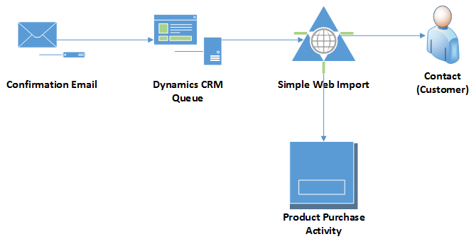
Email Import Process

Slide 20
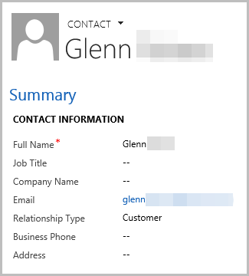
Customer Information
Written to the Contact entity
Relationship Type field set to Customer

Slide 21
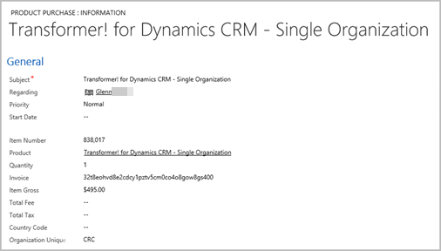
Product Purchase
Custom activity entity

Slide 22
Goal #3: Requirements
Create a product license using information provided in the License Generator record
Attach the product license file to the contact
Email the license file to the contact

Slide 23
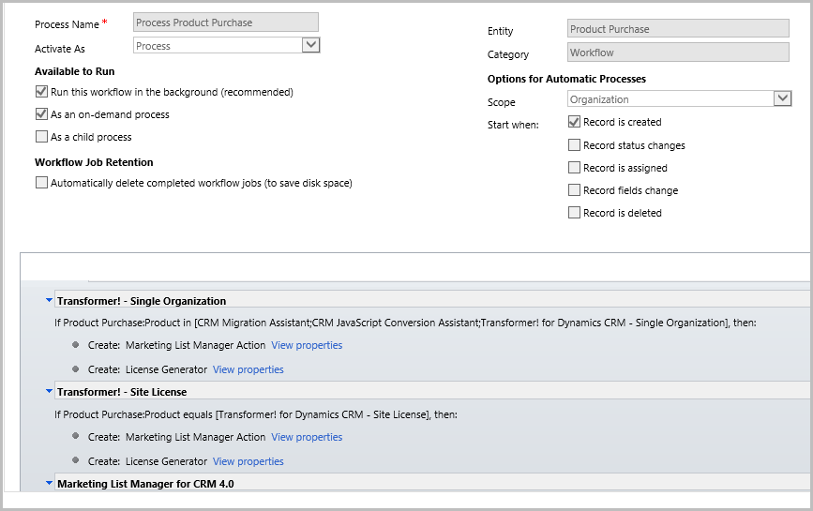
Process Product Purchase Workflow
Creates license generator
Adds contact to marketing list

Slide 24
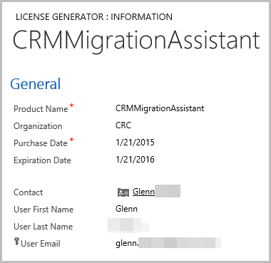
License Generator
Custom entity

Slide 25
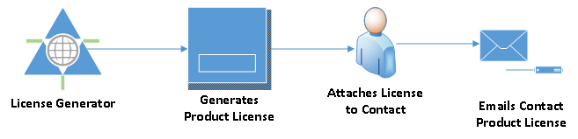
License Generator Process

Slide 26
Drawbacks
Modification of the email body by Exchange
Outbound e–mail (router, server–side sync)

Slide 27
Summary
Goals
Physical product sale
Capture customer and product information
Product license creation and delivery

Slide 28
Questions?

Slide 29
Thank You

